Slide 1



Galaxy training: variant calling with usegalaxy.be
16 September 2020

Slide 2
Materials
Slides: https://github.com/vibbits/galaxy-variantcalling
Shared Data in UseGalaxy Belgium: https://usegalaxy.be/

Slide 3
Learning objectives
Familiarize with the Usegalaxy platform
Make your own analysis by uploading data & using the built-in tools
Identification of genetic variations using basic variant calling pipeline
Create & share workflows for automated analysis
Share data and results (histories) for collaboration purposes

Slide 4
Content
Introduction – what is Galaxy & why should we use it?
Use Galaxy:
Upload data
History
Using tools
Name tags
Workflows
Share history & workflows
Extra: multiple dataset handling

Slide 5
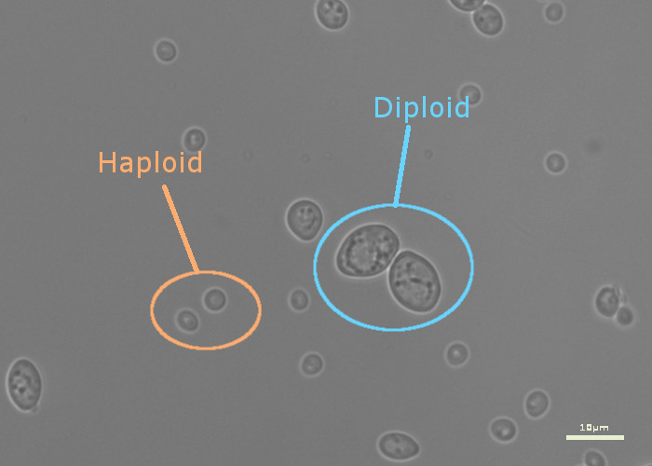
Sequencing Data for today
Haploid Saccharomyces cerevisiae (Yeast) isolate genome sequencing
Nextera DNA library prep
Illumina HiSeq2000 100bp paired-end reads
Reference genome: UCSC Yeast Chromosome 1
Notes:
5

Slide 6

Further reading
More tutorials can be found on: https://galaxyproject.github.io/training-material/

Slide 7
Content
Introduction – what is Galaxy & why should we use it?
UseGalaxy:
Upload data
History
Using tools
Name tags
Workflows
Share history & workflows
Extra: multiple dataset handling

Slide 8
What is Galaxy?
A point-and-click interface that allows researchers to easily create and run sequence analyses
Several instances:
Usegalaxy.org in US
Usegalaxy.eu in Europe
Usegalaxy.be in Belgium
Alternative: command-line tools

Slide 9
Why should we use Galaxy?
Advantages
Accessibility
Reproducibility
Transparency
Community centered
Disadvantages
Flexibility
Performance
Routine

Slide 10
Galaxy platform
Open https://usegalaxy.be and register/login

Slide 11
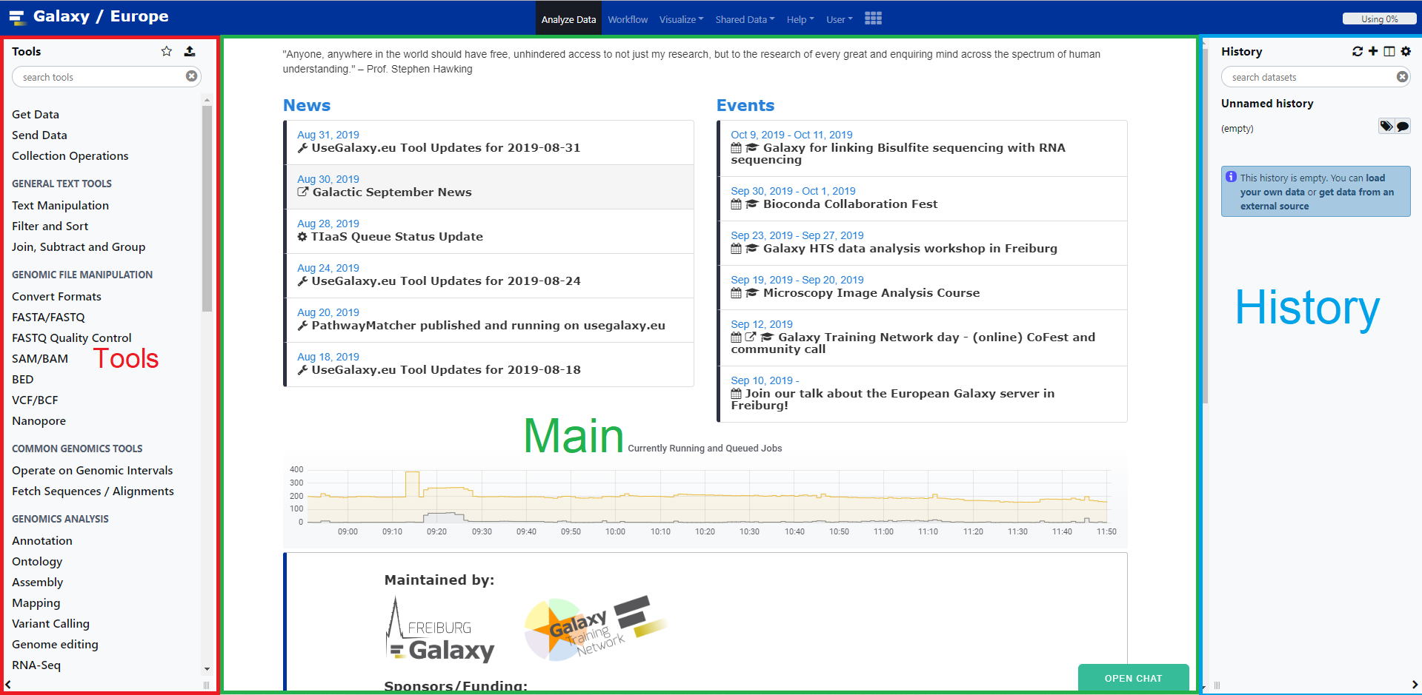
Galaxy interface

Slide 12
Login & account
Make an account by registering, or login with your existing account. It’s also possible to login with your ELIXIR account. This can be based on your personal or institution’s mail address.
Activate your account by verifying via mail.
Doesn’t work on internet explorer.

Slide 13
Galaxy interface
Link | Usage
Analyze Data | Homepage
Workflow | Access existing workflows or create new one
Visualize | Create new visualizations of your data
Shared data | Access data libraries, histories, workflows, etc.
Help | links to Galaxy Help Forum (Q&A), Galaxy Community Hub (Wiki), and Interactive Tours
User | Your preferences and saved histories, datasets and visualizations

Slide 14
Content
Introduction – what is Galaxy & why should we use it?
Use Galaxy:
Upload data
History
Using tools
Name tags
Workflows
Share history & workflows
Extra: Name tags & multiple dataset handling

Slide 15
1. Upload data
Importing data can be done in several ways
Copy/paste text from a file
Files from local computer
From internet using URL
FTP (>2Gb files)
Online databases
Shared Data (libraries, histories, pages)

Slide 16
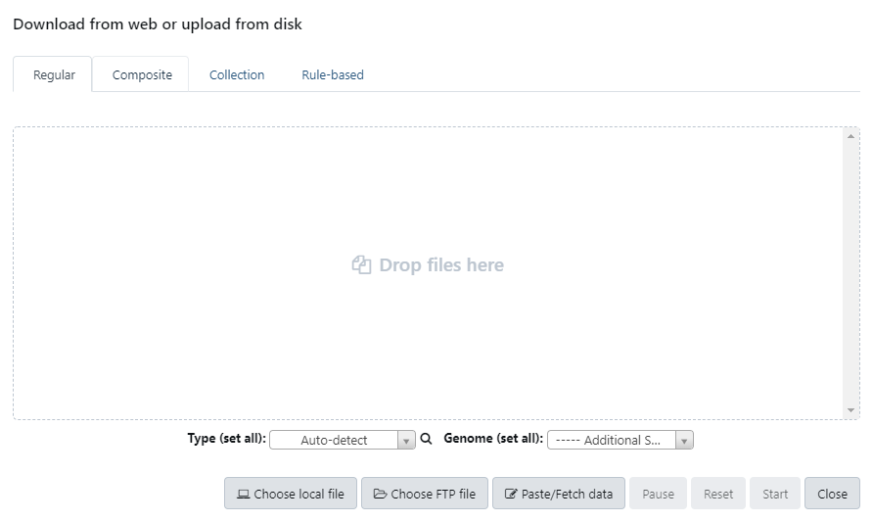
1. Upload data – copy/paste, local, FTP & URL
Click on the Upload File button (left panel)

Slide 17
1. Upload data – copy/paste, local, FTP & URL
Click on the Upload File button (left panel)
Set datatypes & reference genome
Once you have set everything, start the upload process
When uploading, you can close the form.
The items will appear in the history panel and show green when they are ready to be used

Slide 18
1. Upload data – Shared Data
Shared data → Data Libraries
Shared data → Histories

Slide 19
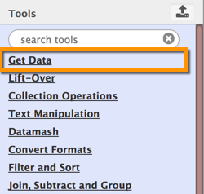
1. Upload data – Online databases
E.g.: UCSC, BioMart, ENCODE, modENCODE, Flymine etc.
Click on the Get Data toolbox (left panel)

Slide 20
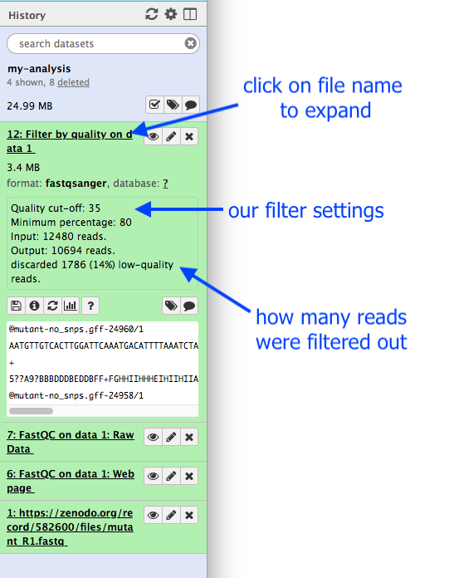
2. History
Location of all analyses
collects all datasets produced by tools
collects all operations performed on the data
For each dataset, the history tracks
name, format, size, creation time, datatype-specific metadata
tool ID, version, inputs, parameters
state (waiting, running, success, failed)

Slide 21
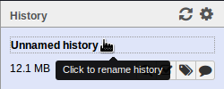
2. History
You can have as many histories as you want
Good practice to always make a new history
Should have a meaningful name. Rename them by clicking on the history name:

Slide 22
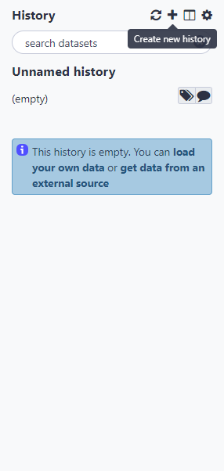

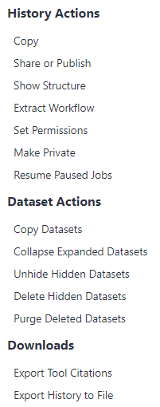
The Galaxy platform: History
Manage history
Refresh history
Create new history
Overview of all generated histories
History options

Slide 23
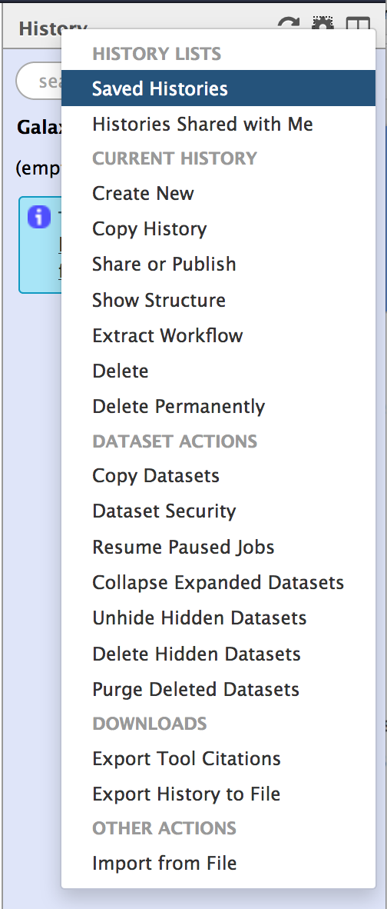
2. History
Create New history will not make your current history disappear
To see all of your histories, use the history switcher
Extract workflow
Copy datasets

Slide 24
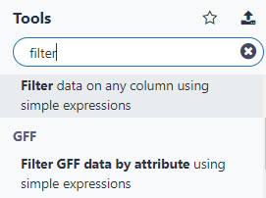
3. Tools
Tool search

Slide 25
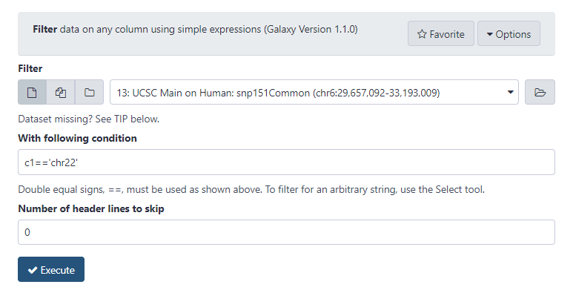
3. Tools
Tool interface:
Input datasets & parameters
Help, citations, information
Execute-button to start a job
New tools can be installed without removing old ones (reproducibility)
Versions!

Slide 26
Exercise – Upload data in history
Import sequencing reads:
From Shared Data → History → Galaxy_training_ELIXIR_16sept → Import history (+ symbol)
Rename history & datasets if you like

Slide 27
Exercise – Upload data in history
Import Yeast reference genome (from online database UCSC)
Tool: UCSC Main
“clade”: Other
“genome”: S. cerevisiae
“assembly”: Apr. 2011 (SacCer_Apr2011/sacCer3)
“group”: Mapping and Sequencing
“track”: Assembly
“table”: gold
“region” should be changed to position with value chrI
“output format”: ‘sequence’
“Send output to” should have the option Galaxy checked
‘get output’ and ‘Send query to Galaxy’
Rename the dataset

Slide 28
Content
Introduction – what is Galaxy & why should we use it?
Use Galaxy:
Upload data
History
Using tools
Name tags
Workflows
Share history & workflows
Extra: multiple dataset handling

Slide 29
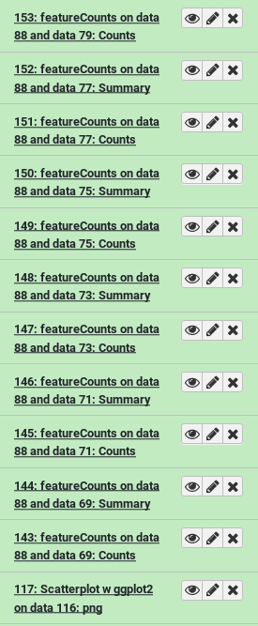
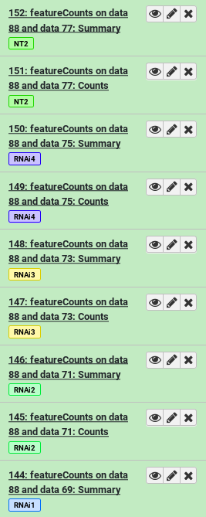
4. Name Tags
After a while, your history may look like this
You have two options to deal with this:
Re-name datasets constantly with more useful titles
Use name tags once, on the inputs to your analysis
# will propagate throughout analysis
Good practice to:
Tag history
Annotate history

Slide 30
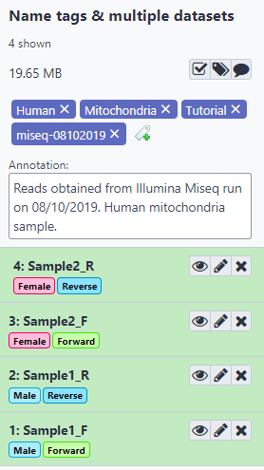
4. Name Tags
Tag history
Choose some random words
Annotate the history with some information on the experiment
Tag
Sample 1: #male
Sample 2: #female
F: #Forward
R: #Reverse

Slide 31
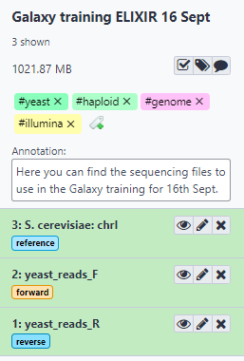
Exercise – Annotate data & history
Tag the data with:
#forward
#reverse
#reference
Annotate and tag the history with some useful information, e.g. tags:
Yeast
haploid
genome
Illumina

Slide 32
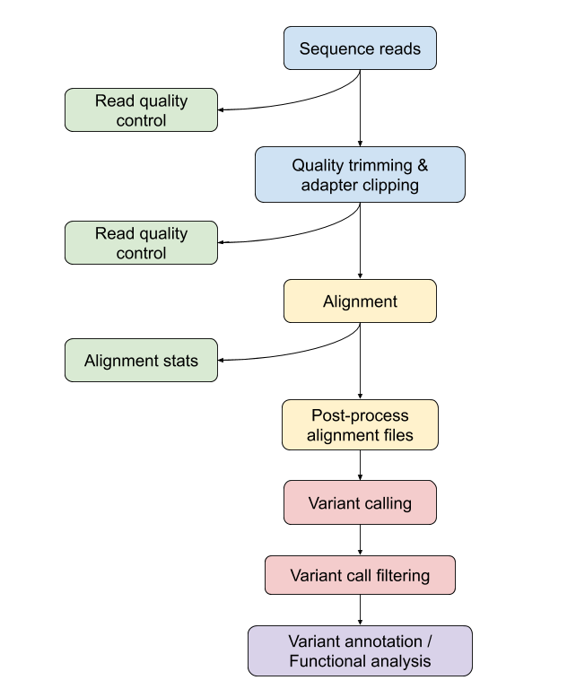
Variant calling

Slide 33
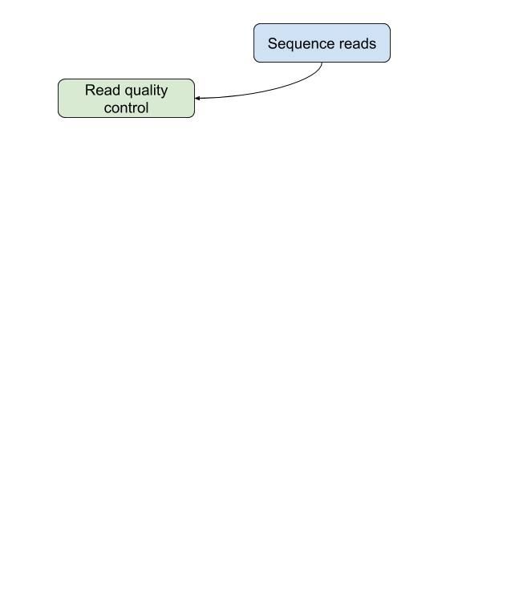
FastQ-file format
Start symbol
Sequence identifier
Sequence
@DCW97JN1:309:C0C42ACXX:5:1111:20484:3491/1 AACATGATATGGCTTTATGTTTCTTTCTTTGATATTTTAGATTCAGGAACTATGAGACATTATGTATTGAT
+ ADCCBJ@@ACLHJGCCCBL?BCIFCAGHCCMDC=ACDC=LDCCGDLHDEHHDCLDLDHDCCC:IBDCCJDD
Quality score
‘+’ sign

Slide 34
Phred-score
Phred Quality Score | Probability of incorrect base call | Base call accuracy
10 | 1 in 10 | 90%
20 | 1 in 100 | 99%
30 | 1 in 1000 | 99.9%
40 | 1 in 10,000 | 99.99%
50 | 1 in 100,000 | 99.999%
60 | 1 in 1,000,000 | 99.9999%

Slide 35
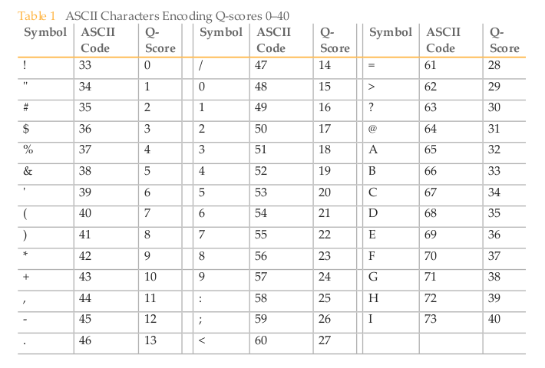
FastQ-file format
@DCW97JN1:309:C0C42ACXX:5:1111:20484:3491/1 AACATGATATGGCTTTATGTTTCTTTCTTTGATATTTTAGATTCAGGAACTATGAGACATTATGTATTGAT
+ ADCCBJ@@ACLHJGCCCBL?BCIFCAGHCCMDC=ACDC=LDCCGDLHDEHHDCLDLDHDCCC:IBDCCJDD

Slide 36
Quality control
Assess quality of raw sequence reads
Remove low quality reads, trim adapters, remove contamination, etc.
! Always perform QC on your data
Tool: FastQC

Slide 37
Do FastQC and then discuss results

Slide 38
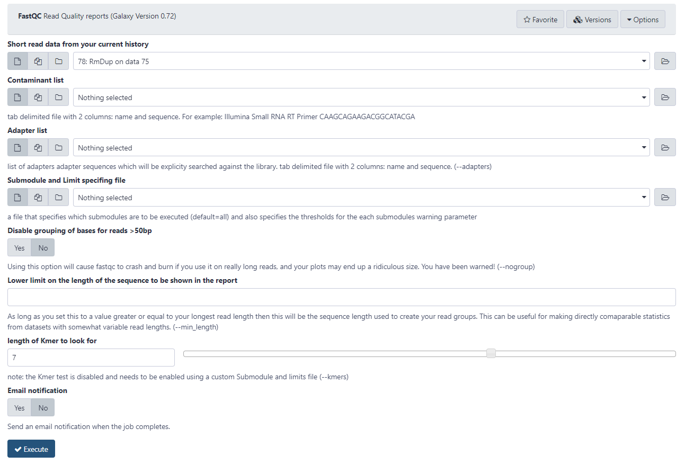
Quality control - FastQC
Automatic loading of potential input files from your history
Run tool on
multiple input
files = batch mode
Nothing selected searches built-in library of known contaminants
Specify list of adapters which will be explicitly searched against
Nothing selected generates full report

Slide 39
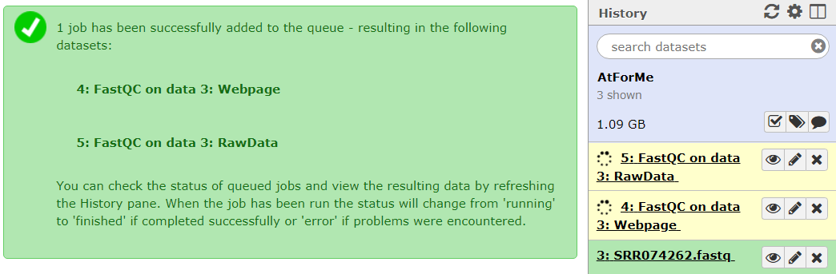
Quality control - FastQC
If it takes long:
Refresh history
FASTQC generates 2 outputs
Webpage = report
Raw data of report: figures...
Yellow: tool is running

Slide 40
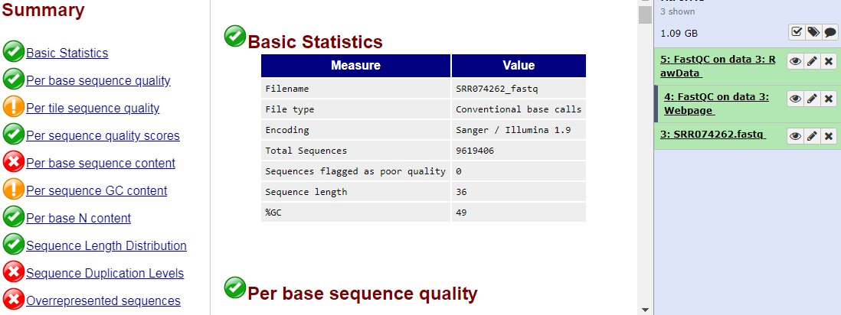
Quality control - FastQC
View output
Green: tool succeeded

Slide 41
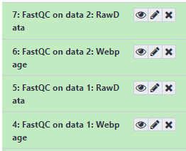
Exercise - Quality control - FastQC
Perform FastQC
Click on eye-icon of webpage to view result
Discuss results
Further reading: GTN Quality Control

Slide 42
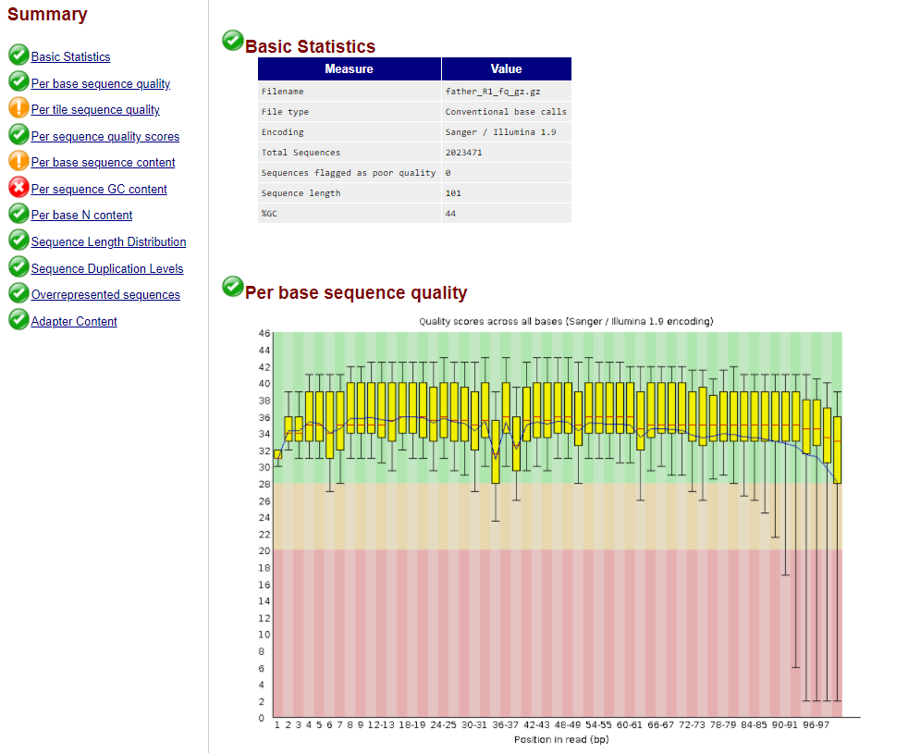

Slide 43
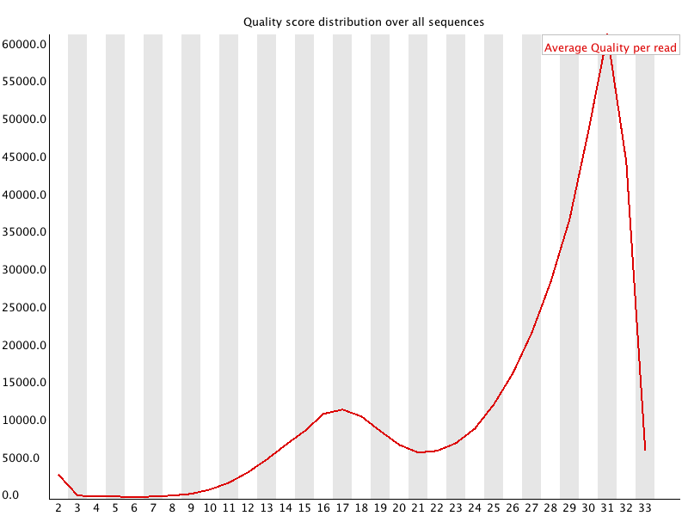
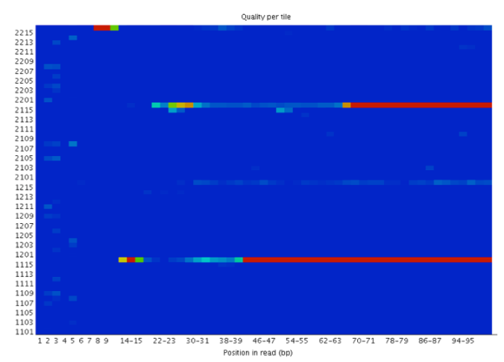
Filtering low quality reads
Parameters in Galaxy:
AVGQUAL
Mimimum quality to keep

Slide 44
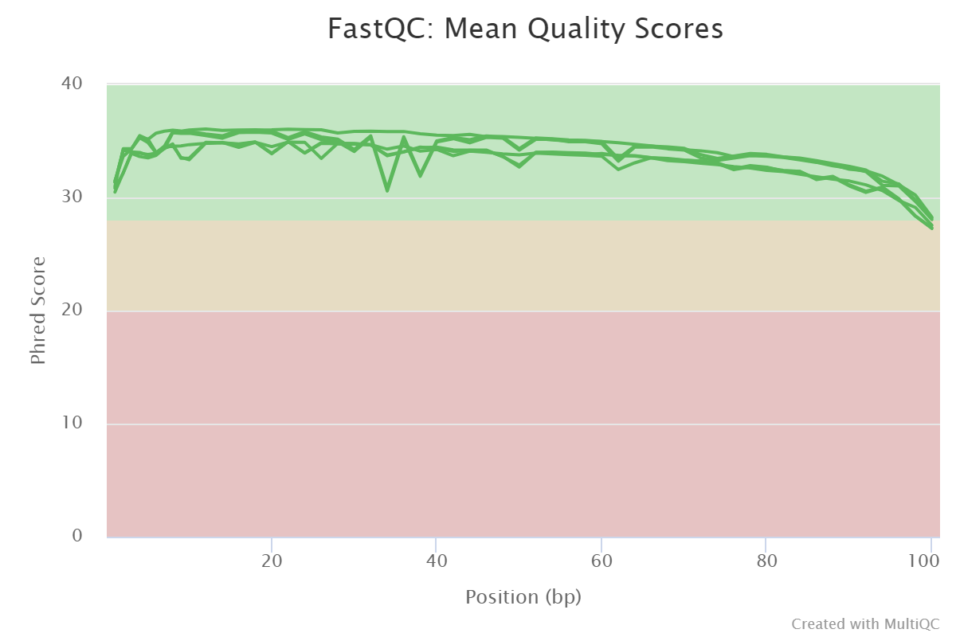
MultiQC

Slide 45
Quality control
Improving the quality of sequencing reads with
Low average quality score
Too small
Overload on N-bases
Based on GC-content
Trimming adapters
Cutting low quality beginning or ending of reads
…

Slide 46
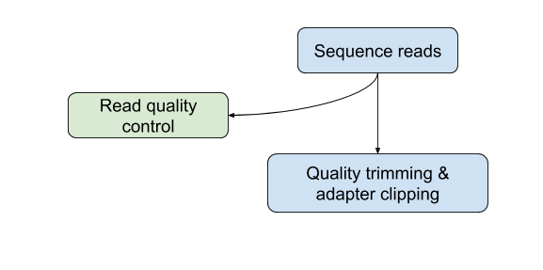
Quality trimming & filtering
Trimmomatic: A flexible read trimming tool for Illumina NGS data
Result = cleaned and high-quality reads
Output for PE reads : 2x trimmed PE reads, 2x trimmed Unpaired Reads
Many quality filters and trimming options:
ILLUMINACLIP, SLIDINGWINDOW, LEADING, TRAILING, CROP, HEADCROP, MINLEN, AVGQUAL

Slide 47
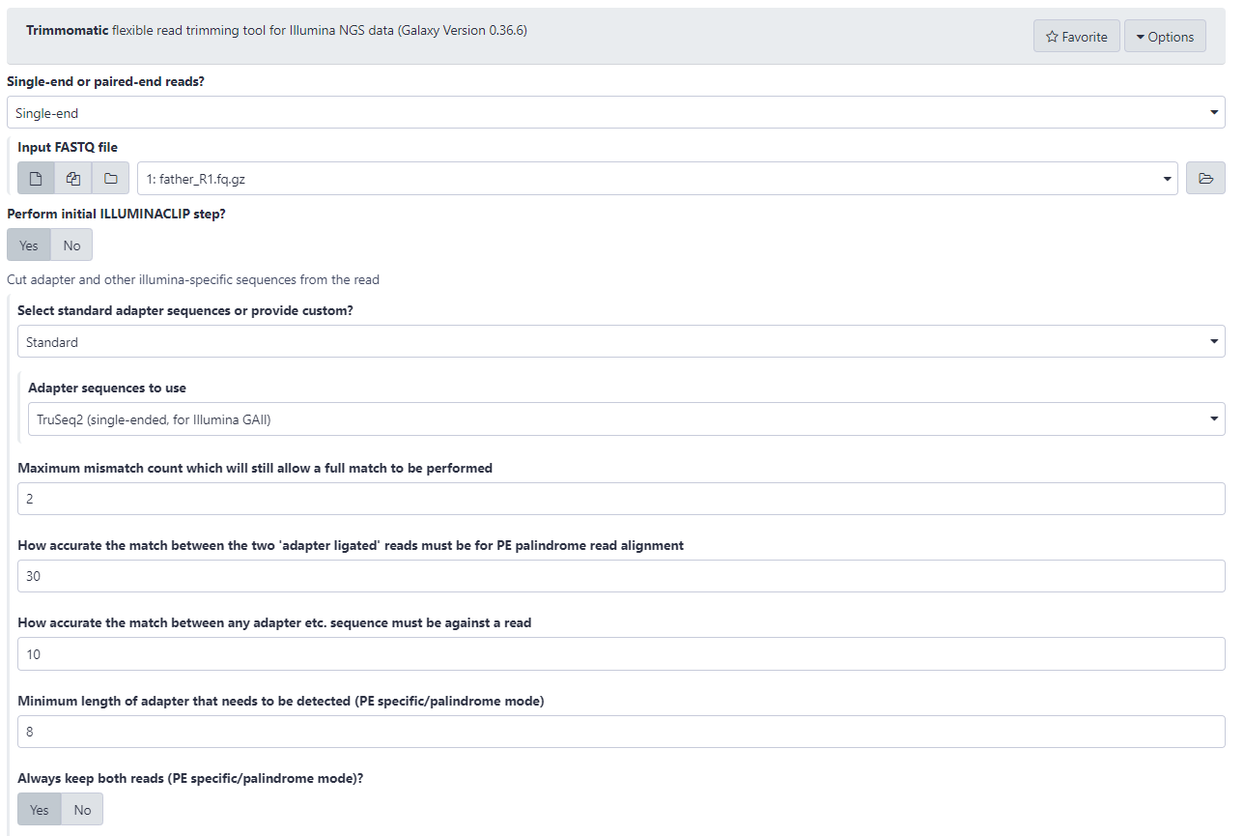
Input sequence(s)
Adapter trimming?
Built-in or own adapter?
Adapter sequence in fasta format
Number of mismatches in seed alignment
Minimum alignment score for paired end reads
Minimum alignment score for single end reads
Only for paired end reads
Discard both reads when one read of the pair is discarded?

Slide 48
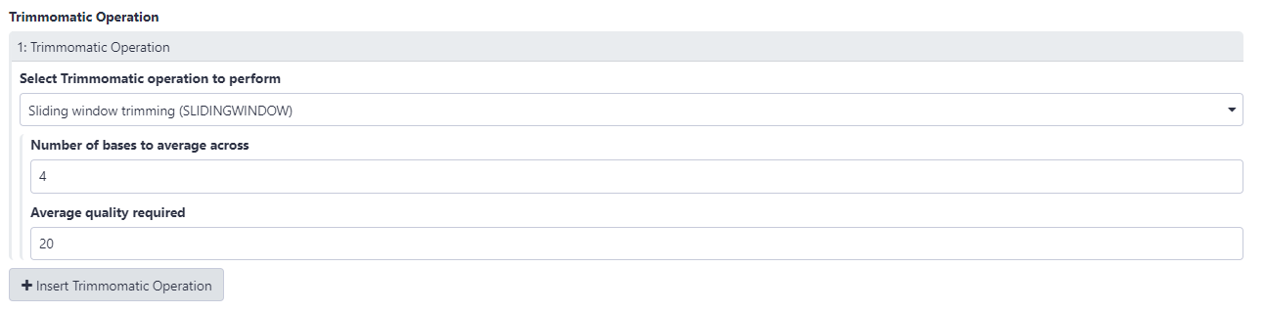

Slide 49
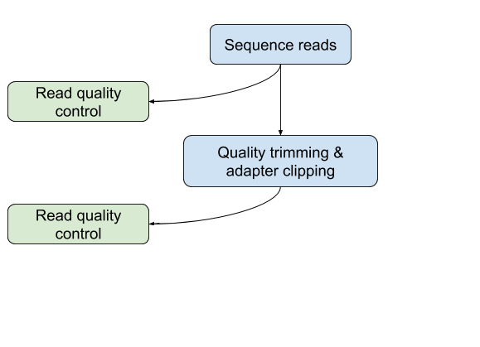
Exercise – quality trimming & filtering
Improve quality of the paired-end dataset
Do not perform ILLUMINACLIP
Sliding window trimming (SLIDINGWINDOW) 4-20
Discard all reads with an average quality score < 30
Perform quality control on new fastq files (cleaned reads) with FastQC
Check the improvement of the quality

Slide 50
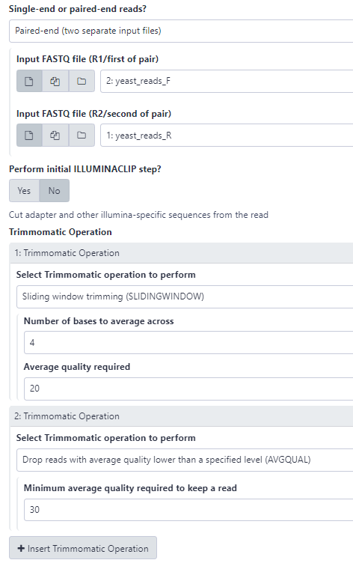

Slide 51
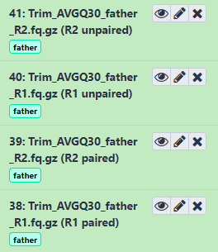
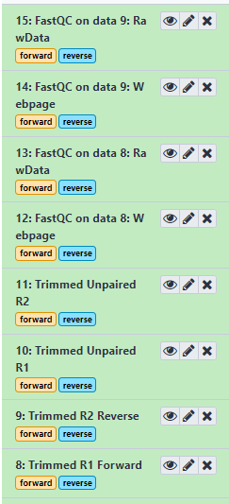
Exercise – quality trimming & filtering
Show multiQC

Slide 52
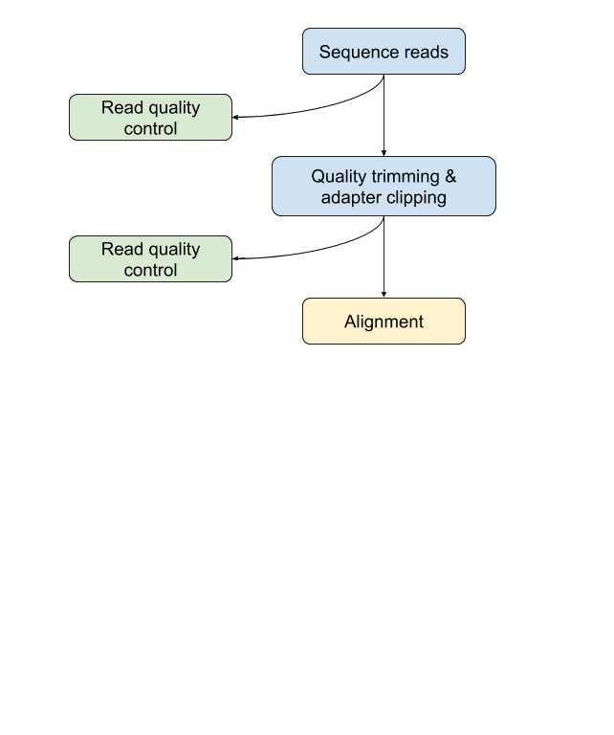
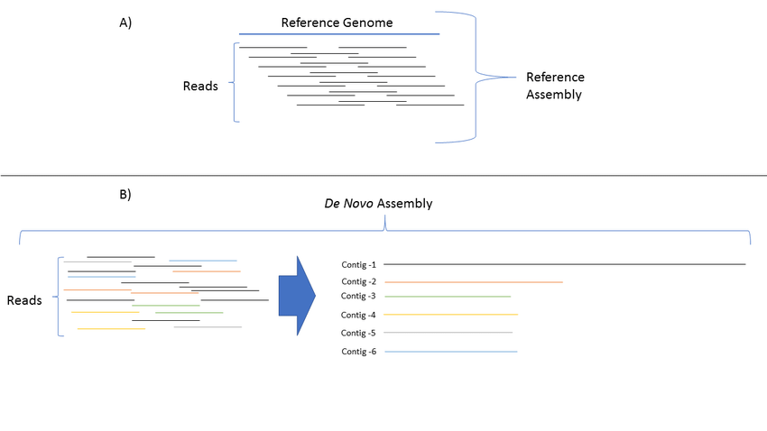
Alignment

Slide 53
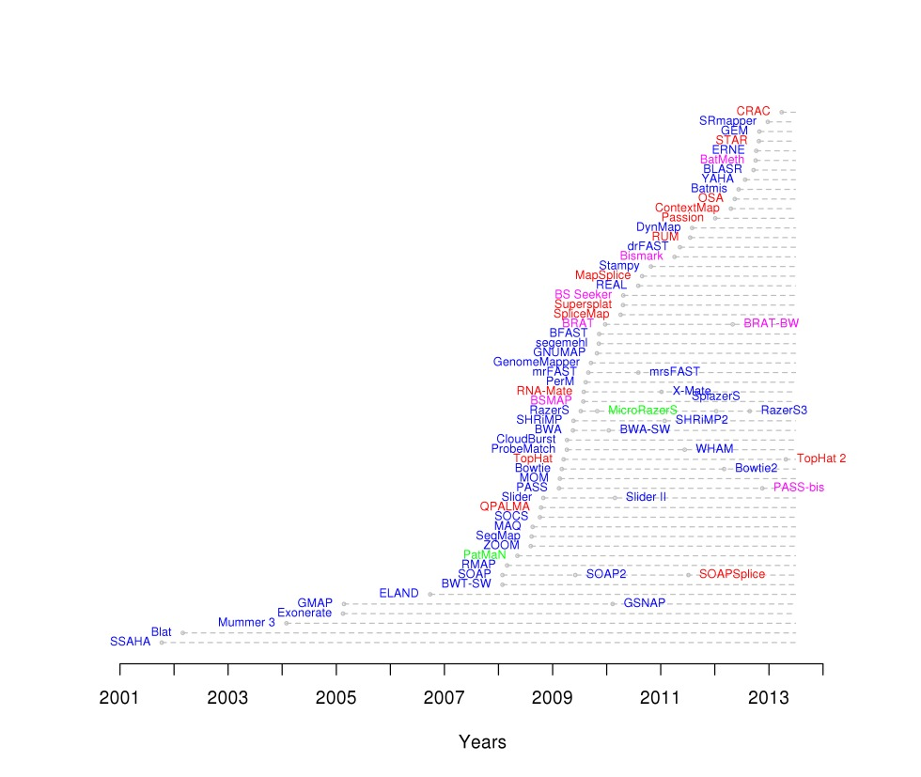
Alignment
Many aligners!
Know your needs & know your data!
Source: https://academic.oup.com/bioinformatics/article/28/24/3169/245777

Slide 54
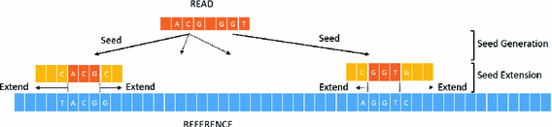
Alignment
Most popular DNA aligners: BWA & Bowtie2
Each aligner has many parameters depending on the underlying algorithm
Best hit(s) stored in SAM/BAM file (output)
Source: https://link.springer.com/chapter/10.1007/978-3-319-30695-7_10

Slide 55
Alignment – SAM file
Col | Field | Type | Brief description
1 | QNAME | String | Name of the read (same as FASTQ file)
2 | FLAG | Int | bitwise FLAG: details of mapping
3 | RNAME | String | Name of reference sequence
4 | POS | Int | Start position of alignment on reference
5 | MAPQ | Int | Mapping Quality
6 | CIGAR | String | CIGAR String: represents actual alignment
7 | RNEXT | String | Ref. name of the mate/next read
8 | PNEXT | Int | Position of the mate/next read
9 | TLEN | Int | Observed Template LENgth
10 | SEQ | String | segment SEQuence
11 | QUAL | String | ASCII of Phred-scaled base QUALity+33
Sequence Alignment Map format
Two parts:
Header information starts with @
Read alignment information
FLAG: https://www.samformat.info/sam-format-flag
@HD VN:1.3 SO:coordinate
@SQ SN:chr8 LN:146364022
@RG ID:000 SM:father PL:ILLUMINA
QNAME | FLAG | RNAME | POS | MAPQ | CIGAR | RNEXT | PNEXT | TLEN | SEQ | QUAL | OPT
DCW97JN1:309:C0C42ACXX:4:1115:17796:60101 | 163 | chr8 | 11712 | 15 | 101M | = | 11869 | 253 | ATGGCAGAGC… | @>DHGADA>:… | NM, MD, RG, …
DCW97JN1:309:C0C42ACXX:5:1216:6300:20909 | 99 | chr8 | 11783 | 27 | 101M | = | 11966 | 271 | AGCCACGTCT… | ?CADBE-A11=… | NM, MD, RG, …
DCW97JN1:309:C0C42ACXX:4:1206:10027:62829 | 83 | chr8 | 11864 | 1 | 101M | = | 11712 | -253 | AAGCCATGGT… | ###########... | NM, MD, RG, …

Slide 56
Exercise – Alignment – BWA
Map with BWA:
Use the imported genome from history
Select paired fastq and use your (trimmed) fastq files
Set read groups information (SAM/BAM):
ID: 001
SM: triplicate1
E.g. in case you have multiple samples.
Sample | ID | SM
father_R1/2.fq.gz | 000 | father
mother_R1/2.fq.gz | 001 | mother
proband_R1/2.fq.gz | 002 | proband

Slide 57
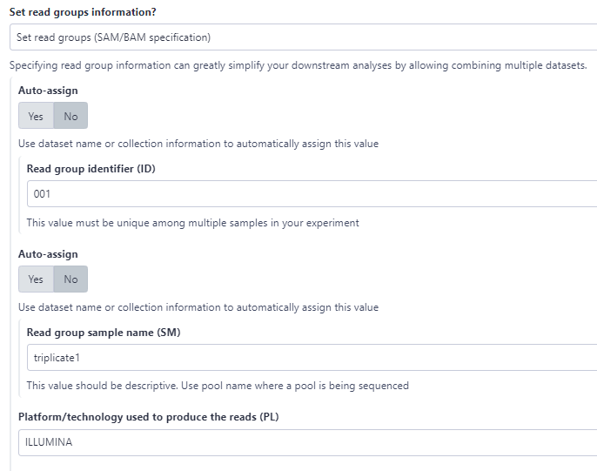
Exercise – Alignment – BWA
Tool

Slide 58
Exercise – Alignment – BWA
Output – Have a look with eye icon.
QNAME | FLAG | RNAME | POS | MAPQ | CIGAR | MRNM | MPOS | ISIZE | SEQ | QUAL | OPT
@HD VN:1.3 SO:coordinate
@SQ SN:sacCer3_gold_BK006935.2 LN:230218
@RG ID:001 SM:triplicate1 PL:ILLUMINA
@PG ID:bwa PN:bwa VN:0.7.17-r1188 CL:bwa sampe -r @RG\tID:001\tSM:triplicate1\tPL:ILLUMINA localref.fa first.sai second.sai /srv/galaxy/shared/database/files/076/dataset_76254.dat /srv/galaxy/shared/database/files/076/dataset_76255.dat
HWI-ST871:214:C18DNACXX:3:1107:9165:34675 | 69 | sacCer3_gold_BK006935.2 | 1 | 0 | * | = | 1 | 0 | AGGGTAGTGTTAGGGTAGTGTGGGTGTGTGGGTGTGGTGTG | :=@DADDDHFHDHII22CAEFEFE@F?ECGHGD<?DG?D/? | RG:Z:001
HWI-ST871:214:C18DNACXX:3:1107:9165:34675 | 137 | sacCer3_gold_BK006935.2 | 1 | 0 | 19M | = | 1 | 0 | ACACACCACACCCACACAC | ?@@BDDDD8DFFF?AGI;E | RG:Z:001 XT:A:R NM:i:1 SM:i:0 AM:i:0 X0:i:4 X1:i:2 XM:i:1 XO:i:0 XG:i:0 MD:Z:0C18

Slide 59
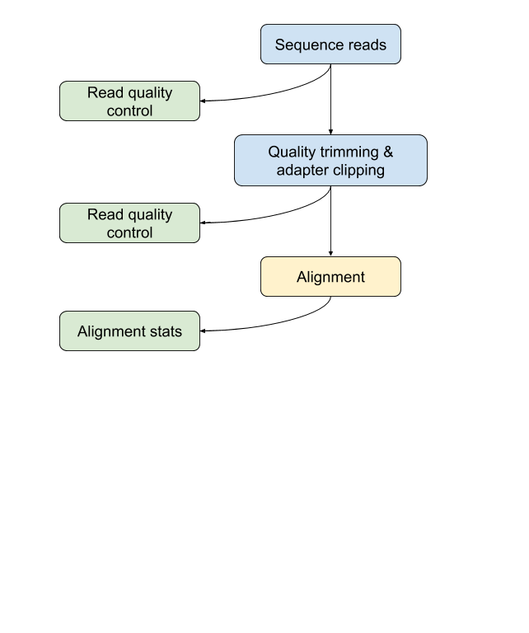
Mapping – quality control
Assess the quality of alignment data:
Samtools flagstat
9558446 + 0 in total (QC-passed reads + QC-failed reads)
0 + 0 secondary
0 + 0 supplementary
0 + 0 duplicates
290263 + 0 mapped (3.04% : N/A)
9558446 + 0 paired in sequencing
4779223 + 0 read1
4779223 + 0 read2
208710 + 0 properly paired (2.18% : N/A)
212144 + 0 with itself and mate mapped
78119 + 0 singletons (0.82% : N/A)
0 + 0 with mate mapped to a different chr
0 + 0 with mate mapped to a different chr (mapQ>=5)

Slide 60
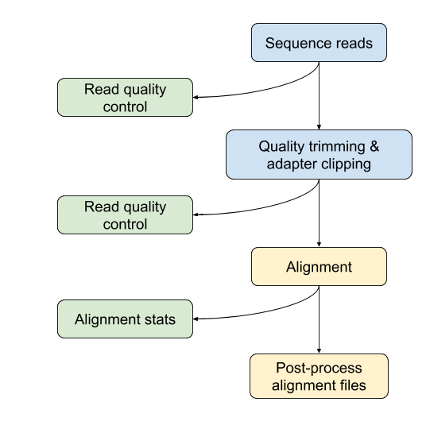
Post-processing alignment
Depends on variant calling software
Alignment sorting, indexing, filtering
Local realignment
Remove duplicates
Base quality score recalibration
Reference
Reads

Slide 61
Exercise – Post-processing alignment
Filter mapped reads
Filter SAM or BAM, output SAM or BAM
Filter on bitwise flag: ‘yes’
Only output alignments with all of these flag bits set: leave empty
Skip alignments with any of these flag bits set:
Read is unmapped
Mate is unmapped
Remove duplicates
RmDup
Is this paired-end or single end data: BAM is paired-end
Treat as single-end: no

Slide 62
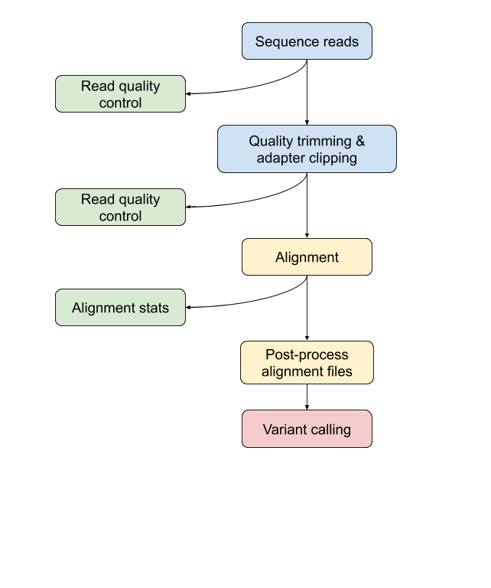
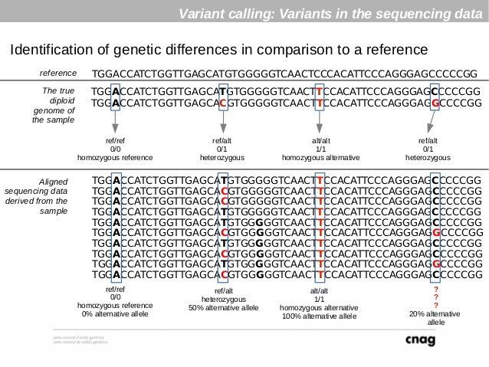
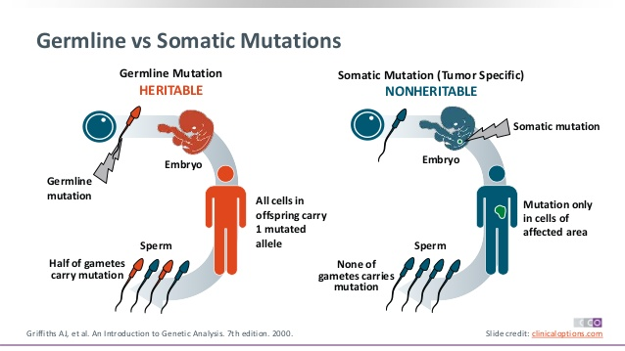
Variant calling
SNPs, InDel, CNV, rearrangements, …
Germline vs somatic mutations

Slide 63
Variant calling
Software packages
Freebayes
+ Easy to run for SNP calling
+ Does not assume any ploidy
+ Fast
GATK (Genome Analysis ToolKit):
+ Different pipelines
+ Sensitive and specific
- More requirements
RG tag has to be present → during mapping

Slide 64
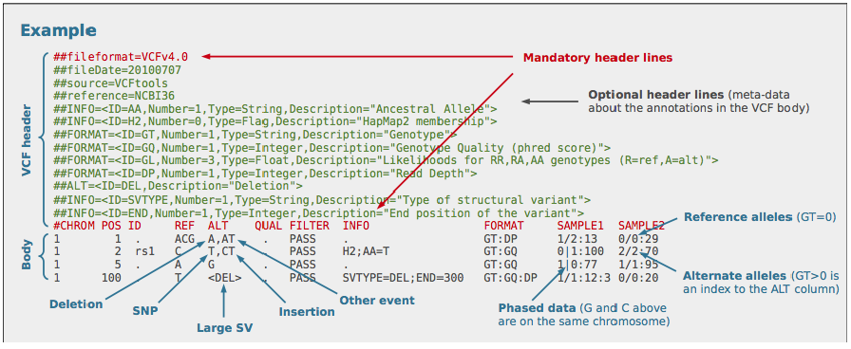
Variant calling – Freebayes
 | Name | Brief description
1 | CHROM | The name of the sequence (typically a chromosome) on which the variation is being called.
2 | POS | The 1-based position of the variation on the given sequence.
3 | ID | The identifier of the variation, e.g. a dbSNP rs identifier, or if unknown a ".".
4 | REF | The reference base at the given position
5 | ALT | The list of alternative alleles at this position.
6 | QUAL | A quality score associated with the inference of the given alleles.
7 | FILTER | A flag indicating which of a given set of filters the variation has passed.
8 | INFO | An extensible list of key-value pairs (fields) describing the variation.
9 | FORMAT | An (optional) extensible list of fields for describing the samples.
+ | SAMPLEs | For each (optional) sample described in the file, values are given for the fields listed in FORMAT
Output: VCF-file (tabular text file)
More information

Slide 65
Exercise – Variant calling – Freebayes
Variant calling: Freebayes
Choose the source of ref: history
Run in batch mode: run individually
BAM dataset: filtered and removed duplicates BAM
Use following dataset as reference: S. cerevisiae chrI
Limit variant calling to a set of regions: do not limit
Choose parameter selection level: 5. Full list of options
Population model options: set population model options:
Set ploidy for analysis to 1.
Click the eye icon & discuss format

Slide 66
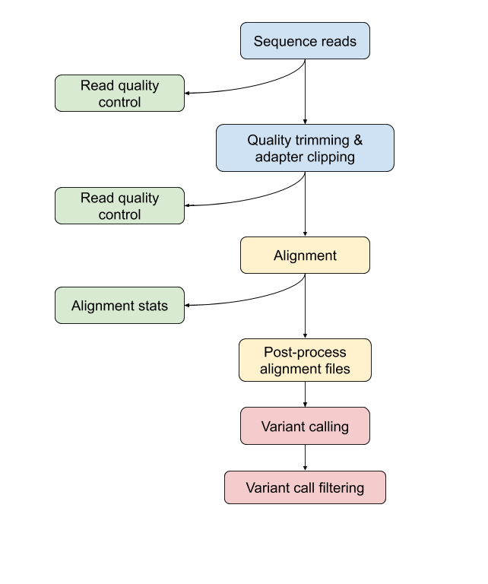
Variant call filtering
Filter low-quality variants
Exclude/include specific type (SNPs, InDels, …)

Slide 67
Exercise - post-process: Filter VCFs
VCFfilter
Select the filter type: Info filter (-f)
QUAL > 40
Insert more filters:
Select the filter type: Info filter (-f)
TYPE = “snp”

Slide 68
Variant annotation
Previously-observed variant
Inside or near a known gene
Genomic region (exon, UTR, etc.)
Site with pathogenic effect
Tools: SnpEff, VCFannotate, Ensembl VEP, Gemini tools

Slide 69
Content
Introduction – what is Galaxy & why should we use it?
Use Galaxy:
Upload data
History
Using tools
Name tags
Workflows
Share history & workflows
Extra: multiple dataset handling

Slide 70
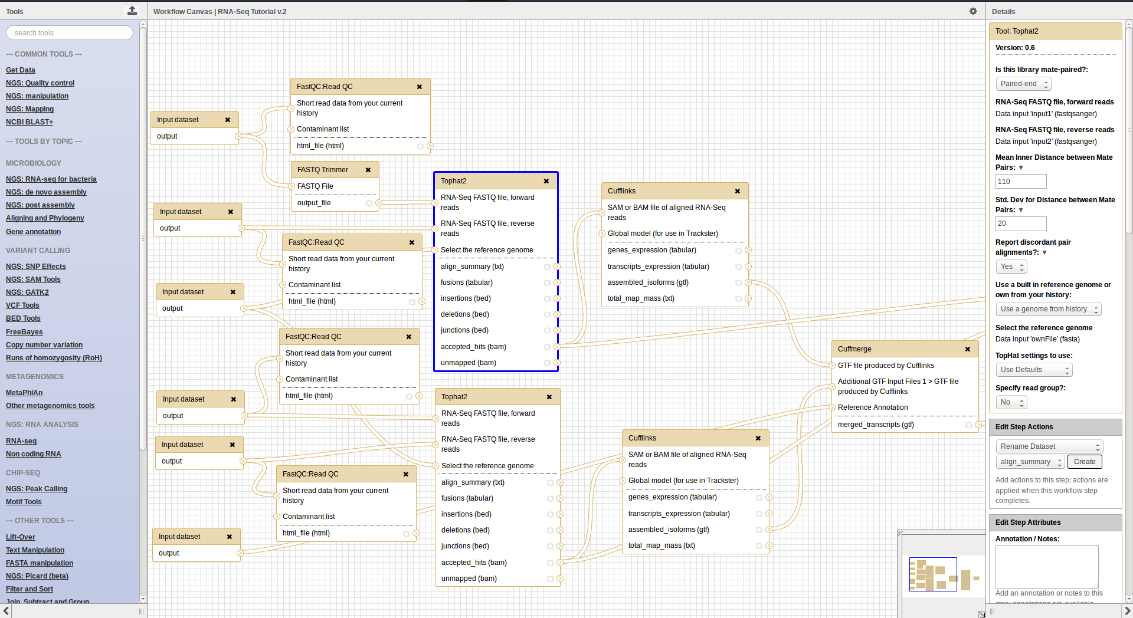
Workflows
Extracted from a history
Built manually by adding and configuring tools using the canvas
Imported using an existing shared workflow

Slide 71
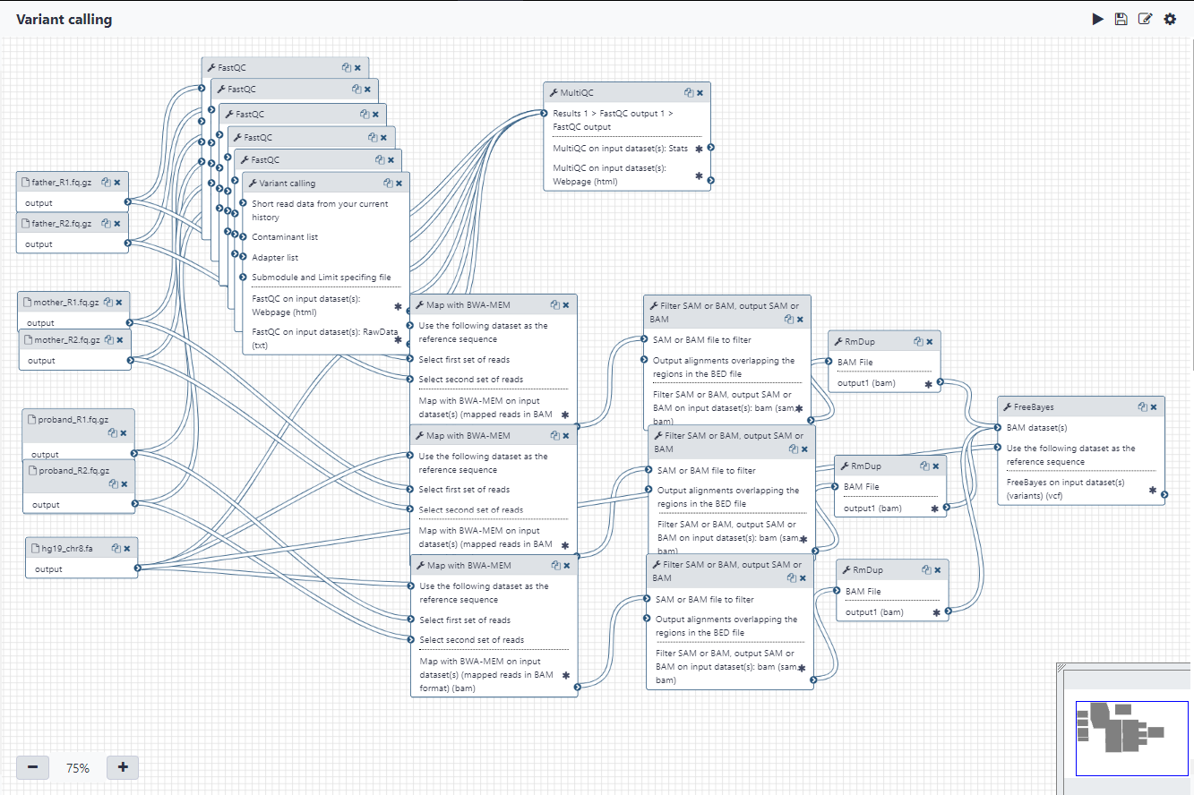

Slide 72
Workflows
Re-run the same analysis on different input data sets
Change parameters before re-running a similar analysis
Make use of the workflow job scheduling
jobs are submitted as soon as their inputs are ready
Share workflows with the community

Slide 73
Exercise
Make a workflow from our history
Re-run the workflow with new datasets
Share your workflow using a link

Slide 74
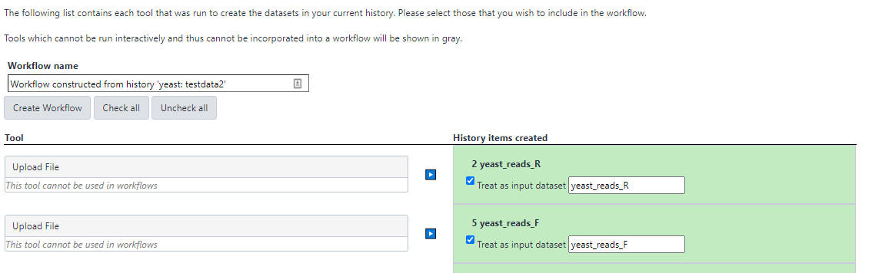
Exercise – Create workflow
Click on the history-wheel and extract workflow from history
Give it a meaningful name
Unselect any of the tools you don’t need
Change name of inputs: Forward & Reverse. Make sure that they are in the right order

Slide 75
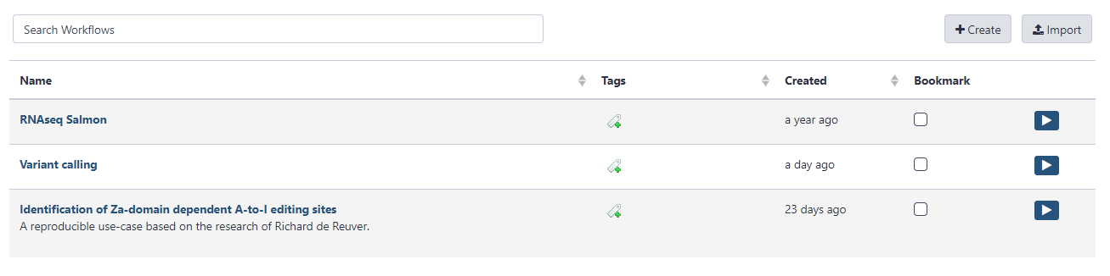
Exercise – Create workflow
Switch to the workflow tab
All of your saved workflows are stored here
Click on workflow & edit
Drag some things around, unhide datasets (see next slide), change parameter VCFfilter quality > 45

Slide 76
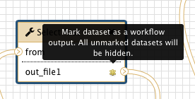
Exercise – Create workflow
Remark: if you want to see intermediate datasets, click unhide datasets
Extra: you can send an alert to e-mail address when the pipeline is finished

Slide 77
Exercise – Rerun workflow
Make a new history & change name
Upload new reference genome – S. cerevisiae chrII from UCSC
Copy the yeast seq reads from previous history/exercise:
Wheel-icon: Copy datasets
Select source and destination history and select the same forward and reverse reads

Slide 78

Exercise – Rerun workflow
Select workflow - workflow
Select the appropriate datasets
You can still edit the parameters
Click run workflow
It’s still possible to change parameters here

Slide 79

Exercise
Workflow is being run:

Slide 80
Content
Introduction – what is Galaxy & why should we use it?
Use Galaxy:
Upload data
History
Using tools
Name tags
Workflows
Share history & workflows
Extra: multiple dataset handling

Slide 81
Sharing histories & workflows
Share everything you do in Galaxy – histories and workflows
Directly using a Galaxy account's email addresses on the same instance
Using a web link, with anyone who knows the link
Using a web link and publishing it to make it accessible to everyone from the Shared Data menu

Slide 82

Exercise – share workflow & history

Slide 83

Exercise – share workflow & history

Slide 84
Content
Introduction – what is Galaxy & why should we use it?
Use Galaxy:
Upload data
History
Using tools
Name tags
Workflows
Share history & workflows
Extra: multiple dataset handling

Slide 85

Name Tags
Upload dataset
Edit names

Slide 86

Multiple datasets
Click on checkbox: Operations on multiple datasets
Check both sample 1
For all selected…
Build Dataset Pair
Repeat for sample 2

Slide 87

Multiple datasets
Perform fastqc on collection
Select Fastqc
Select Collection of datasets

Slide 88

Multiple datasets
Click on checkbox: Operations on multiple datasets
Check all: For all selected…
Build List of Dataset Pairs
Automatically paired
Clear filters & click pairs
Make a name of the list
Create list

Slide 89

Community
Support forum: Galaxy Help
Community curated documentation: Galaxy Community Hub
Events all around the world
Galaxy Training for scientists, developers, admins, instructors: Galaxy Training Community

Slide 90
Extra exercise – Upload data in history
Get sequencing reads:
Download and Extract Reads in FASTA/Q format from NCBI SRA. (sralist.txt)
select input type: ‘List of SRA accession, one per line’
sra accession list: ‘sralist’
Files are organized in a collection containing two outputs
Get reference genome (e.g. yeast chrI)
Adapt & re-run workflow with a collection of reads from SRA
Notes:
90

Slide 91
Extra exercise – Upload data in history
Reads
https://sra-pub-src-1.s3.amazonaws.com/SRR10174389/AHG_S4_R1_001.fastq.gz.1
https://sra-pub-src-1.s3.amazonaws.com/SRR10174389/AHG_S4_R2_001.fastq.gz.1
https://sra-pub-src-1.s3.amazonaws.com/SRR10174395/ACQ_S3_R2_001.fastq.gz.1
https://sra-pub-src-1.s3.amazonaws.com/SRR10174395/ACQ_S3_R2_001.fastq.gz.1

Slide 92
Where do you find the reference genome ?
Built-in in Galaxy
Igenomes + Bowtie website:
http://bowtie-bio.sourceforge.net/bowtie2/index.shtml
http://support.illumina.com/sequencing/sequencing_software/igenome.html
You can immediately use them in Bowtie/HISAT mappers
Ensembl: http://www.ensembl.org/
UCSC: http://genome.ucsc.edu/
NCBI: https://www.ncbi.nlm.nih.gov/
You have to index them first but Galaxy automatically handles this for you

Slide 93
For RNA-Seq you also need annotation
The fasta file only contains the sequence
You also need the location of exons / CDS
You can download these as gtf files from:
- Ensembl
- UCSC
- Human / mouse: GENCODE basic set (= Ensembl + Havana)
https://www.gencodegenes.org/
Gtf files of built-in genomes are in Galaxy
For other genomes you have to upload a gft file

Slide 94

Aligning reads to a reference sequence
Other goals:
Map the reads to find out
Which location on the reference sequence each fragment comes from ?
Which gene ? Which exon ? …
Reference genome/EST sequence(s)
reads
Variant analysis:
Compare the reads and the reference sequence
Identify sequence differences
Unknown known SNP
variant

Slide 95
Tools for mapping DNA-Seq data
BWA: http://bio-bwa.sourceforge.net/
reads < 200nt
Bowtie: http://bowtie-bio.sourceforge.net/bowtie/
Same algorithm as BWA
Faster
Good at aligning short reads (< 50 nt)
Bowtie2: http://bowtie-bio.sourceforge.net/bowtie2/
Better for longer reads (> 50 nt)

Slide 96
Aligning short reads is a challenge
Single end sequencing
read 3
?
Reference
read 1
?
read 2
read 3
?
read 1
?
Many short reads map to multiple locations -> which is right location ?
Paired end sequencing
read 1B
Reference
read 1A
read 1A
read 1B
Reads from a pair have to map to opposite strands
In each others vicinity: separated by fragment length

Slide 97
Example CIGAR – SAM/BAM file
SAM file:
Read001 163 chr20 7 20 8M2I4M1D3M ...
QNAME FLAG RNAME POS MAPQ CIGAR
QNAME Name of the read: same as in FASTQ file
FLAG Bitwise flag: gives details of mapping e.g. strand...
RNAME Name of the reference sequence
POS Position of start alignment on the reference sequence
MAPQ MAPping Quality: same scale as quality scores of bases
CIGAR CIGAR string: represents actual alignment
Alignment: 12345678901234 5678901234567890
Reference: AGCATGTTAGATAA**GATAGCTGTGCTAGTA
Read001+: TTCGATAAAGGATA*CTG
8M: first 8 bases of Read001 match reference
2I: two insertions
1D: a deletion

Slide 98

What is a BAI file ?
SAM and BAM files: Reads are in same order as in fastq file
It’s time-consuming to search such files: e.g. find reads that map to region on chr4
Comparable to searching for a word in a phone book
Indexing the file makes searches faster
add info on location of reads
Like index at the back of a book
Separate file: .bai
You need BAI for visualization
some analysis steps

Slide 99

Causes for duplicates
Optical duplicates
1 cluster that has falsely been called as 2 by Illumina software
PCR duplicates
Duplicates from PCR amplification during sample prep
Distort counts that differentiate sequencing errors from variants

Slide 100
Extra – pileup files
A pileup is essentially a column-wise representation of the aligned reads - at the base level - to the reference. The pileup file summarises all data from the reads at each genomic region that is covered by at least one read. Each row of the pileup file gives similar information to a single vertical column of reads in the IGV view.
The current generation of variant calling tools do not output pileup files, and you don't need to do this section in order to use FreeBayes. However, a pileup file is a good illustration of the evidence the variant caller is looking at internally.

